Slide 1

Simple DC Voltage Stabilizer
By:
Electronics and Design Lab., Group-1
Kirtidipan Behera (110EC0159)
Debashish Shanti (110EC0182)
Subhajit Sahu (110EC0181

Slide 2
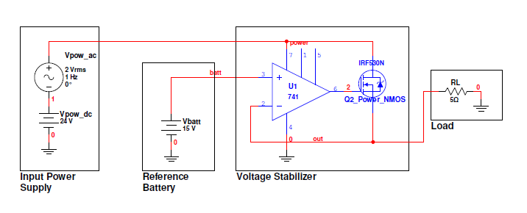
Circuit Diagram
Power Supply DC Value = 24V, Power Supply AC Value = 2V RMS

Slide 3
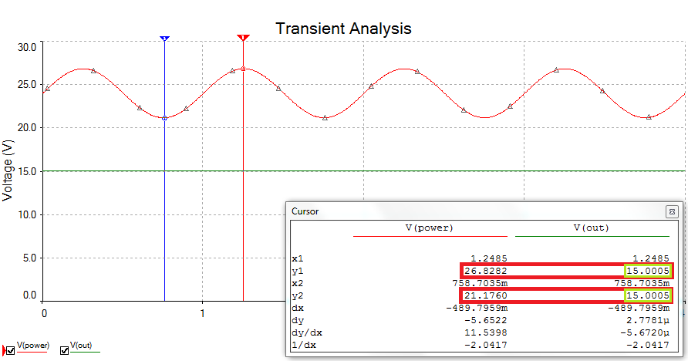
Simulation: Transient Analysis
Voltage of reference battery = 15V

Slide 4
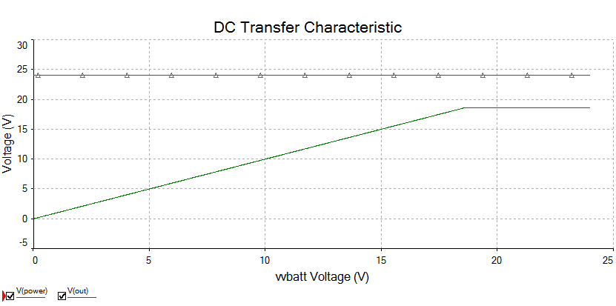
Simulation: DC Sweep Analysis
Voltage of reference battery = 0 to 24V

Slide 5
Working

Slide 6
Assumptions
OpAmp has a definite slew Rate.
OpAmp can be used with a variable power supply.

Slide 7
Component Usage
OpAmp works as a comparator.
Compares output with the reference battery.
OpAmp-output connected to Power NMOS-gate.
NMOS is used as a current valve.
Current flowing through load is controlled to keep the voltage same.

Slide 8
How do you bath?
Cold water valve is already open.
Cold water comes out initially.
Temp. of Hot water you want > Temp. of Cold water.
Slowly open the Hot water valve.
A definite delay after which mixed water starts to come.
Once temp. of Hot water you want < Temp. of mixed water.
Slowly close the Hot water valve.

Slide 9
From Power up
Output is 0V initially.
Reference Voltage > Output Voltage.
OpAmp-output slowly increases (finite slew rate).
After a definite delay NMOS partially switches “on” after Vt.
Output voltage starts to increase as current flows.
Once Reference Voltage < Output Voltage, OpAmp output slowly decreases.
NMOS “on” state partially decreases, thus decreasing the output voltage.

Slide 10
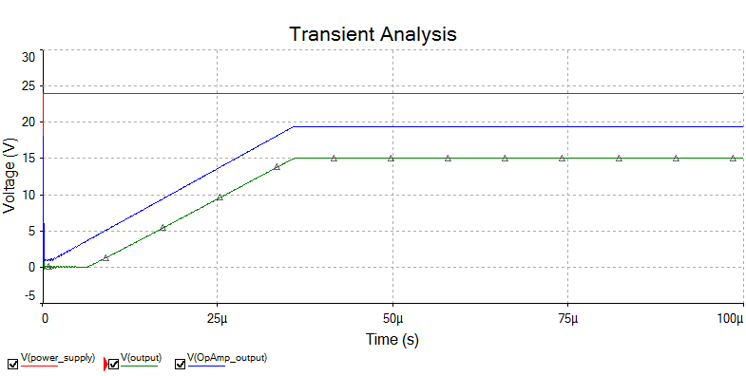
Simulation: From Power Up
Voltage of reference battery = 15V

Slide 11
Conclusion
Simple and easy-to-implement circuit for voltage stabilization.
Lacks a lot of features wrt modern voltage stabilizers.
Modern voltage stabilizers are very efficient, allow a very large load current, and can also boost the output voltage to the required value, even if the supply voltage is less.
However, designing such circuits require a sufficient knowledge, technical people working together, and of course, a lot of experience.
This project is just like a seat belt to an aeroplane.
It was a great learning experience to be able to build a DC voltage stabilizer of our own.

Slide 12
Thank You

